Slide 1

SPOTIFY ANALYSIS USING TABLEAU

Slide 2
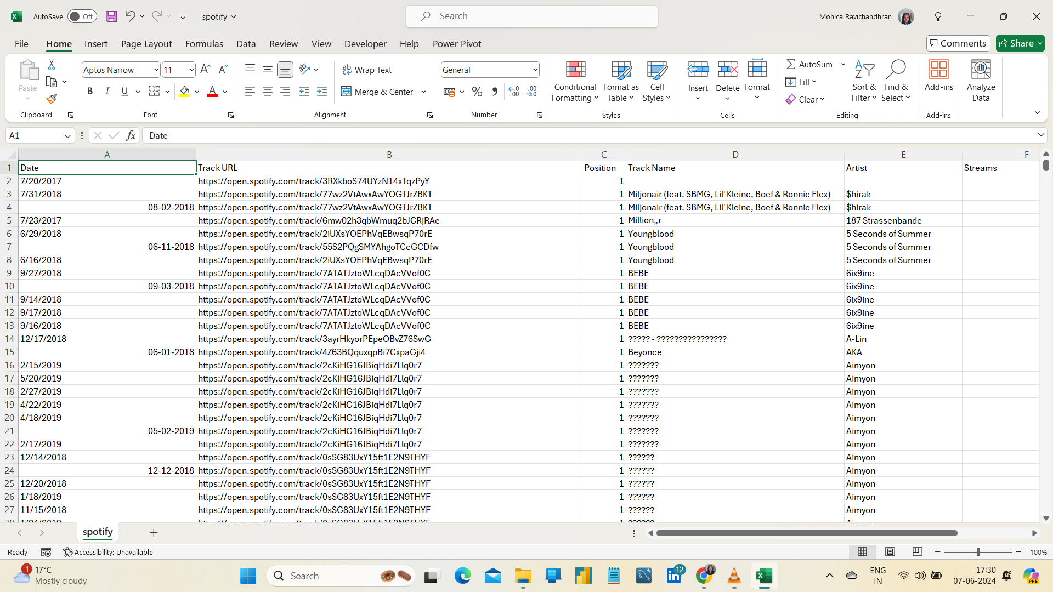
Data cleaning

Slide 3
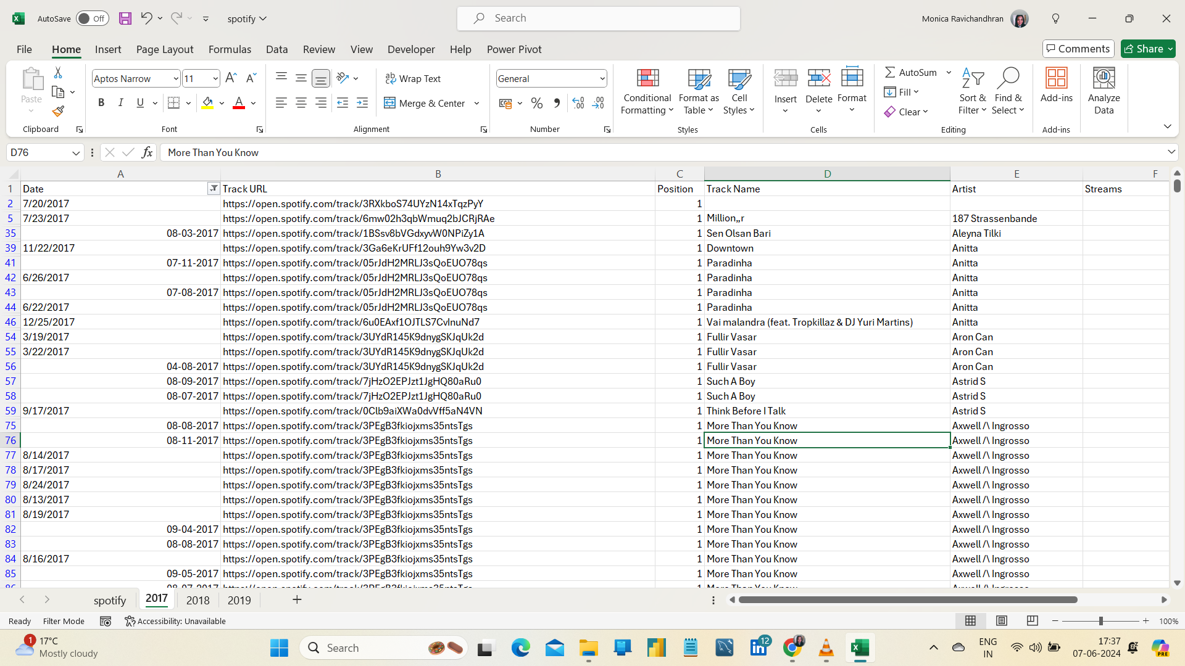

Slide 4
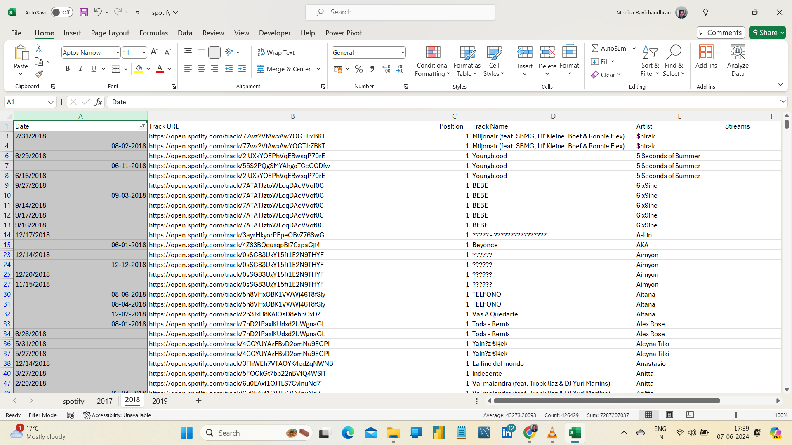

Slide 5
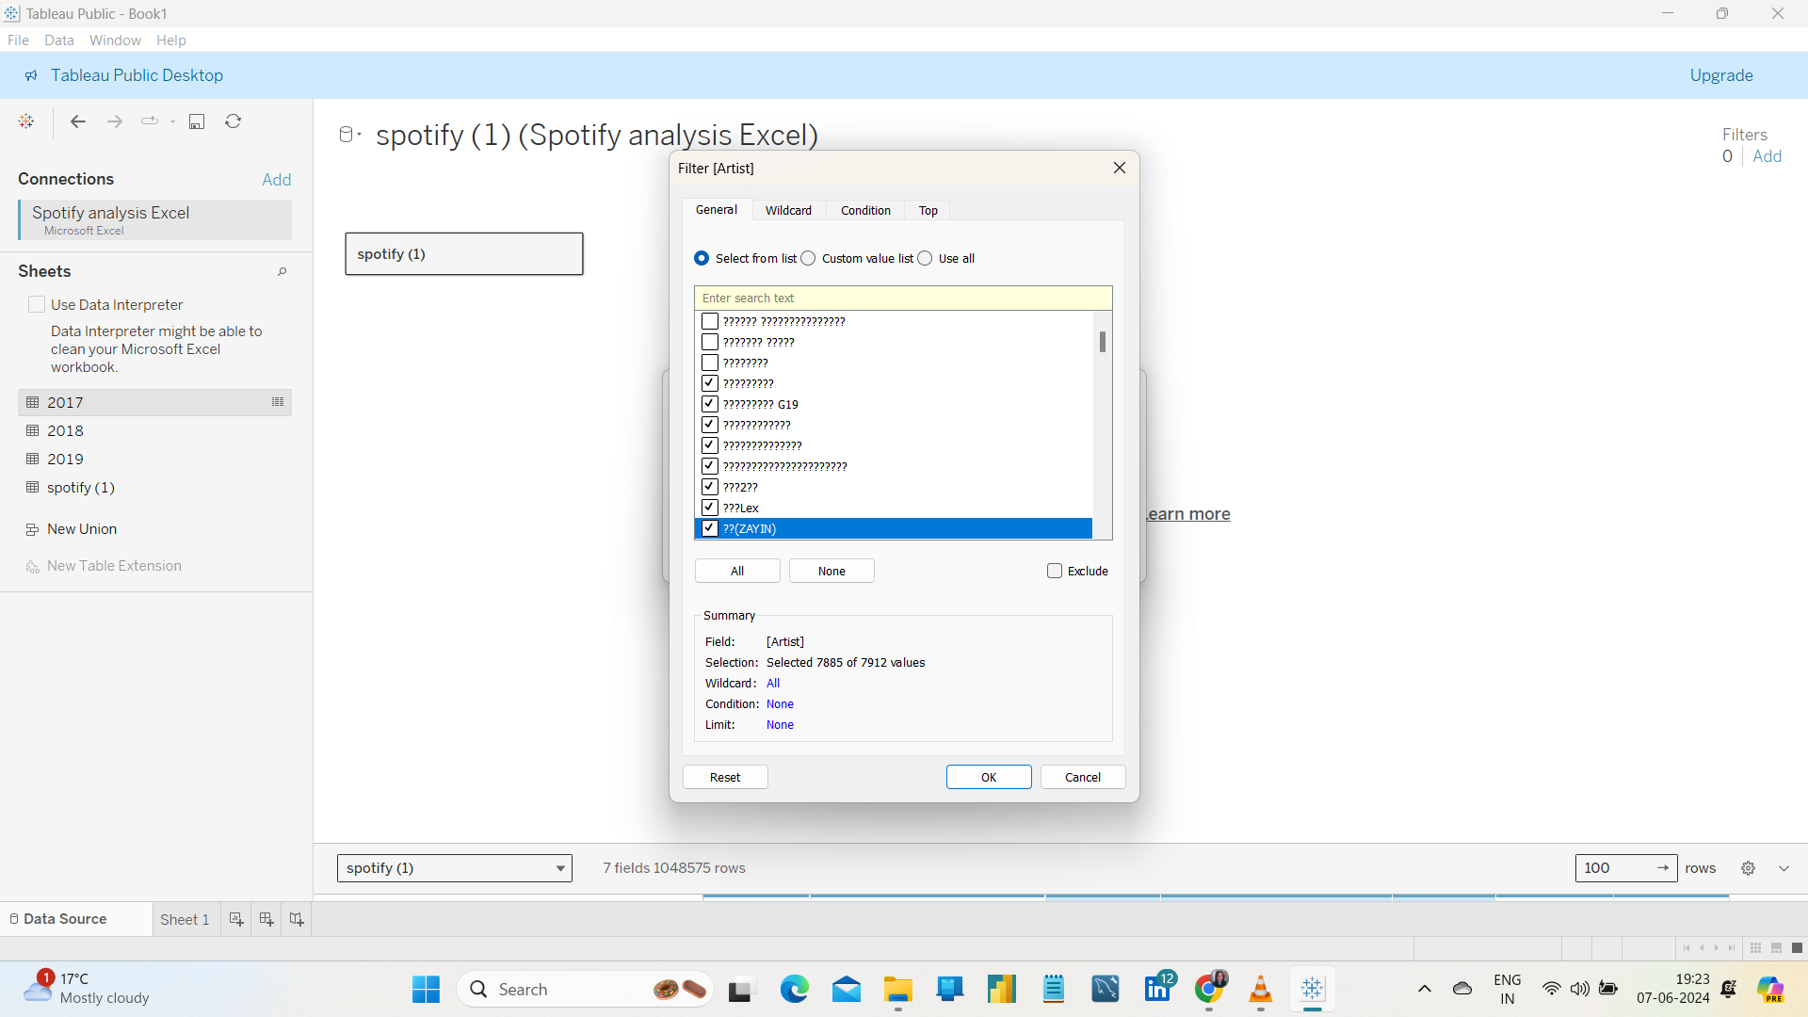

Slide 6
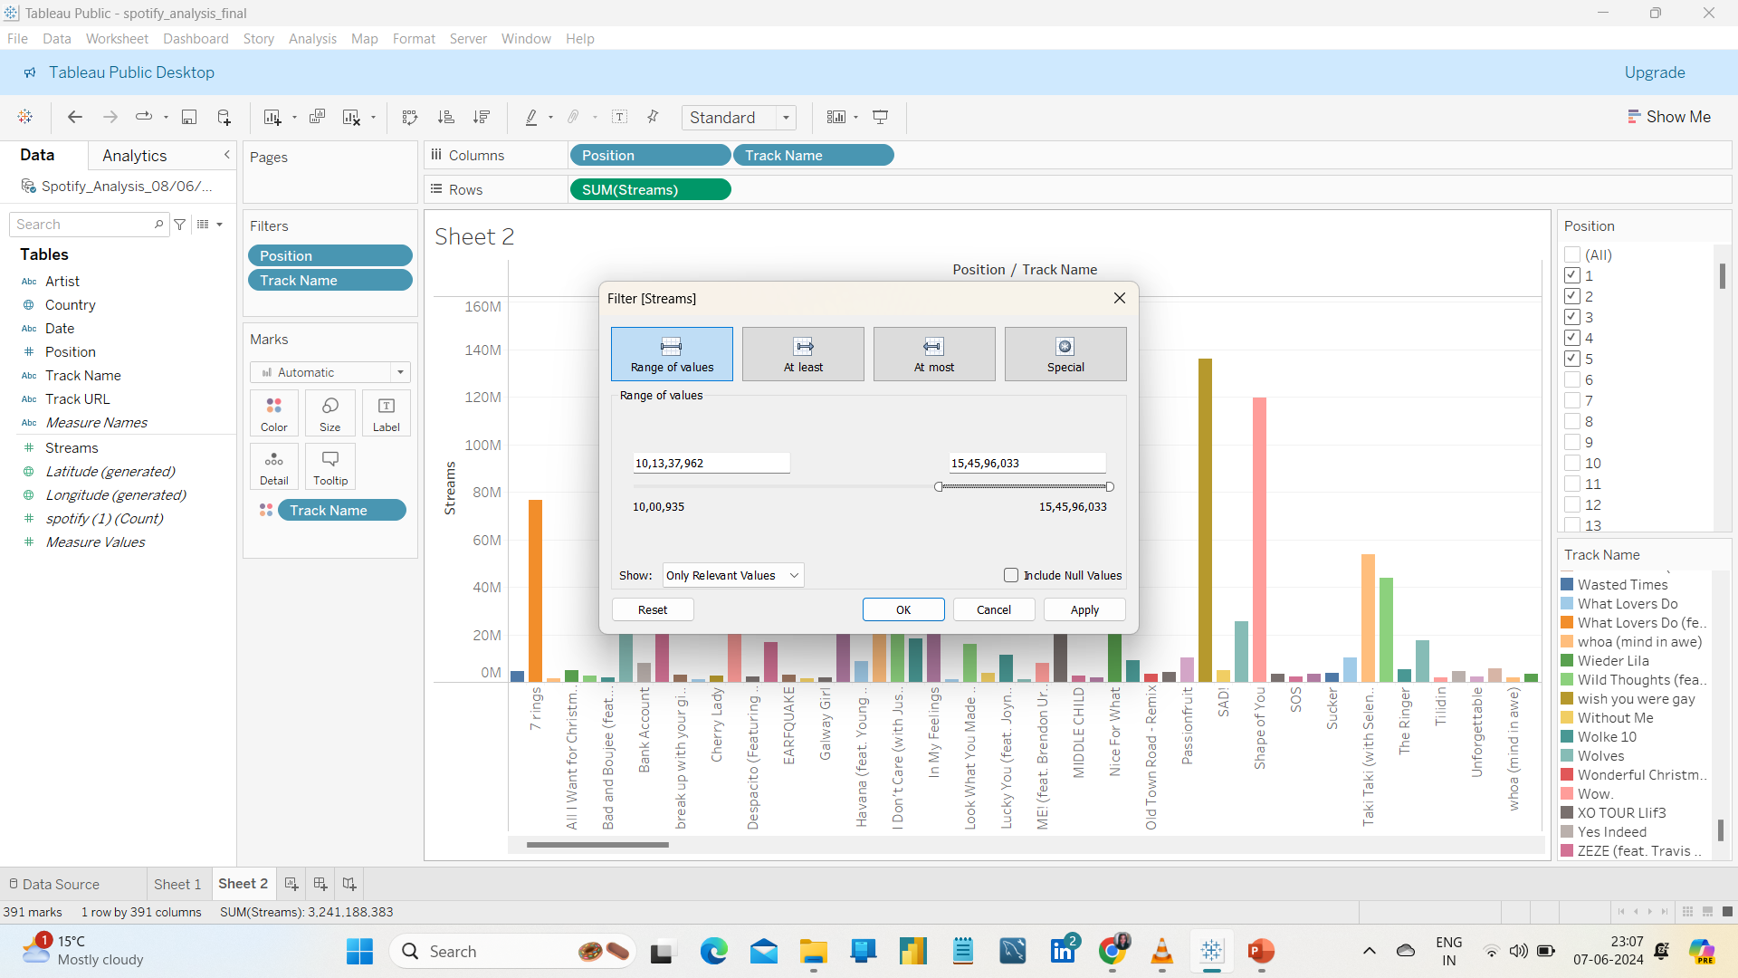

Slide 7
ADVERTISING STRATEGY TO STAY COMPETITIVE IN THE MUSIC INDUSTRY
Make use of social media platforms like Instagram, X(formerly known as Twitter), YouTube, and Facebook to advertise new music albums wisely and make users attractive.
Collaborating with influencers on Instagram and YouTube with short videos helps users engage with new music trends.
YouTube ads with visually appealing content will attract the listener.
Can wisely use streaming platforms(such as SPOTIFY, I TUNES, YOUTUBE MUSIC ETC.,) to advertise their music content with the visually treated contents. So that the listener gets attracted towards the music composition quickly.

